Slide 1
Inherited pt
New Opioid Rx
Prior to appt
Prescriber appointment
UDT Results
Rx maintenance
Identify change in PCP; notify PCP re: protocol
Identify new UDT results and review
New Opioid Rx?
Risk stratify next UDT for mid-cycle; order UDT in EHR; consider referral to pain clinic and med taper; notify prescriber
Virtual Center of Excellence*
Aberrant
Y
Diversion
Illicit Drugs
Consider for SUD
N
Y
Notify Prescriber
N
Call patient in for repeat
Schedule patient return to PJC; document UDT in huddle note where applicable
Pharmacy Tech
Give pt cup, ask dot phrase questions
MA
Continue opioid therapy
Discuss if COT best option; discuss OTA; Naloxone Rx and education; Order UDT
Do not pursue Opioid Rx; refer to alt. therapies
Do not pursue Opioid Rx; refer to alt. therapies
Writes
e-Rx
Do not pursue Opioid Rx; seek alt. therapies
End Opioid Rx; refer to alt therapies
Refer to Bridge
Continue Rx course
Seek alt. therapies; pain clinic, pain coach
Prescriber
N
Y
Sign OTA; Consents to UDT
N
Gives urine sample
N
Patient
Y
Y
Leaves PJC
Initiation Point
Virtual Center of Excellence:
PharmD, MD Director

Slide 2
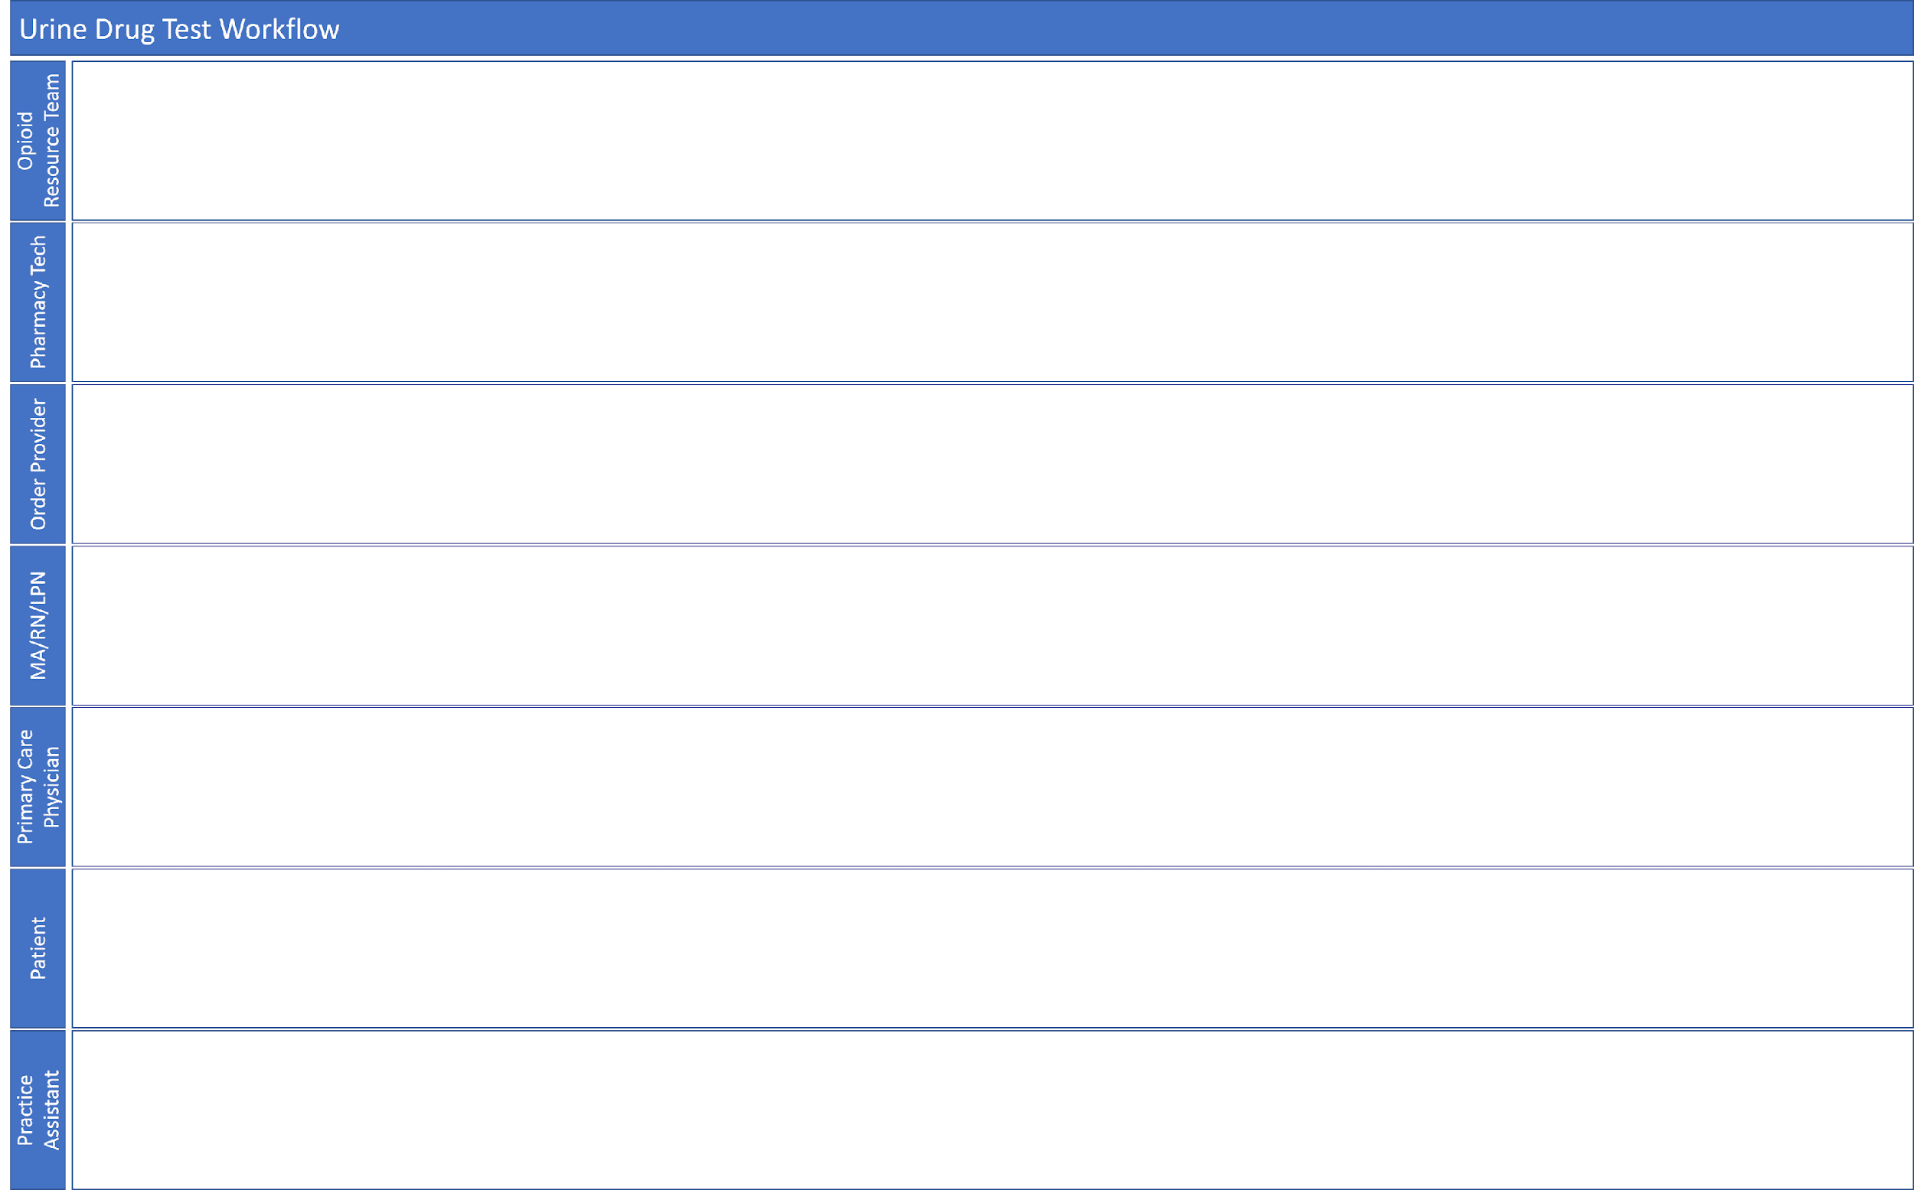
Review patient case, remove from list
Queue opioid Rx, consult list of patients due for UDT this month
N ?
Runner responds “reply all” to “BWH Jen Ctr Nurses” to say UDT needed
Should patient be on “pend UDT” list?
Red Sticker?
Give patient script; END
Y
Pend UDT for pts on “pend UDT” list
“RN send script to MD and pend it”
Nurse “books patient”; creates phone encounter; looks for UDT order
N
Give pt cup, ask dot phrase questions
Obtain sample; alert pharm tech, bring sample to lab
Y
Sign off on script, UDT order in inbasket
Arrives for pickup
N
N
START
Consents to UDT
Y
Produce Sample?
Y
Goes to restroom
Emails “BWH Jen Ctr Nurses” to say pt in
Trigger?
Y
N?

